Slide 1
A definition of scale-independent communities & a flow-free vertex cut algorithm
Alexander Braekevelt, Pieter Leyman & Patrick De Causmaecker
Department of Computer Science, KU Leuven, Belgium

Slide 2
What is the subject?

Slide 3
We collect a lot of data...

Slide 4
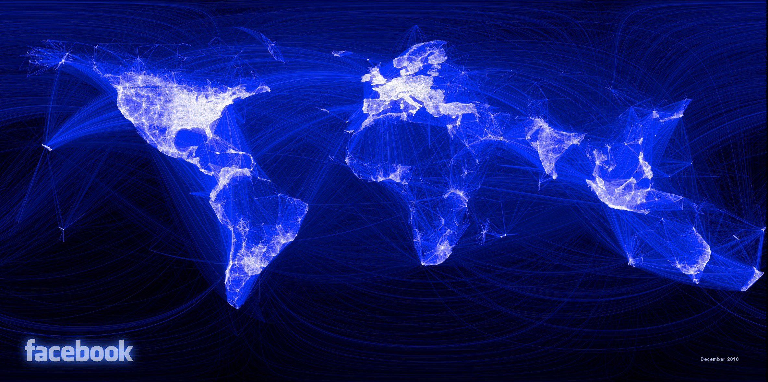
We collect a lot of data...
social networks
Image source: Paul Butler, facebook intern, 14 december 2010

Slide 5
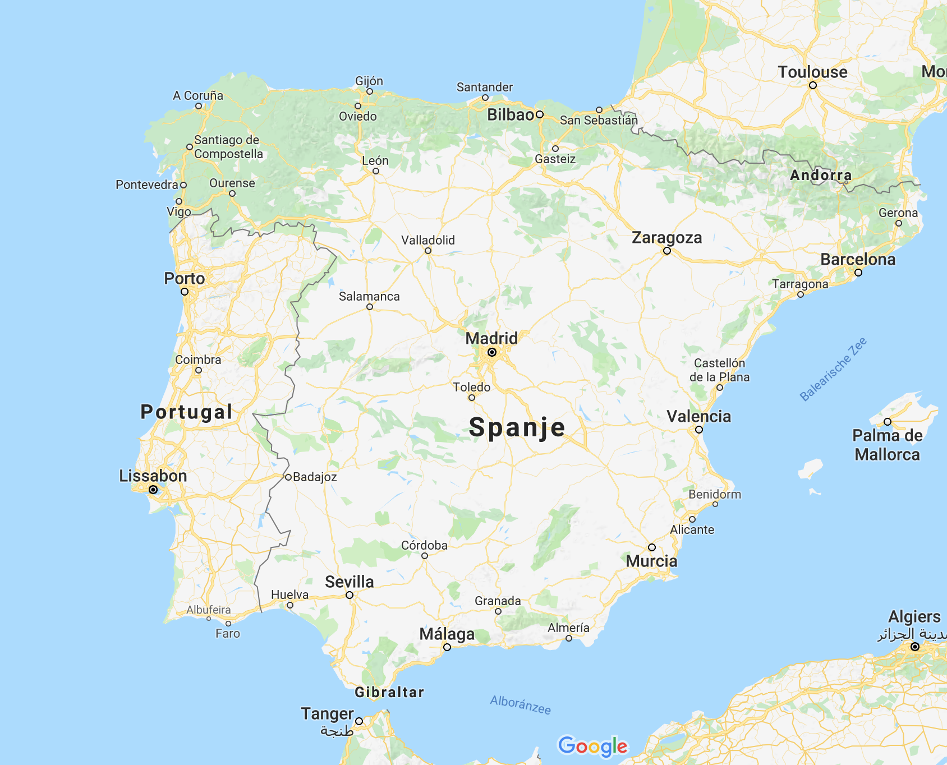
We collect a lot of data...
social networks
street maps
Image source: ©2018 Google, Inst. Geogr. Nacional

Slide 6
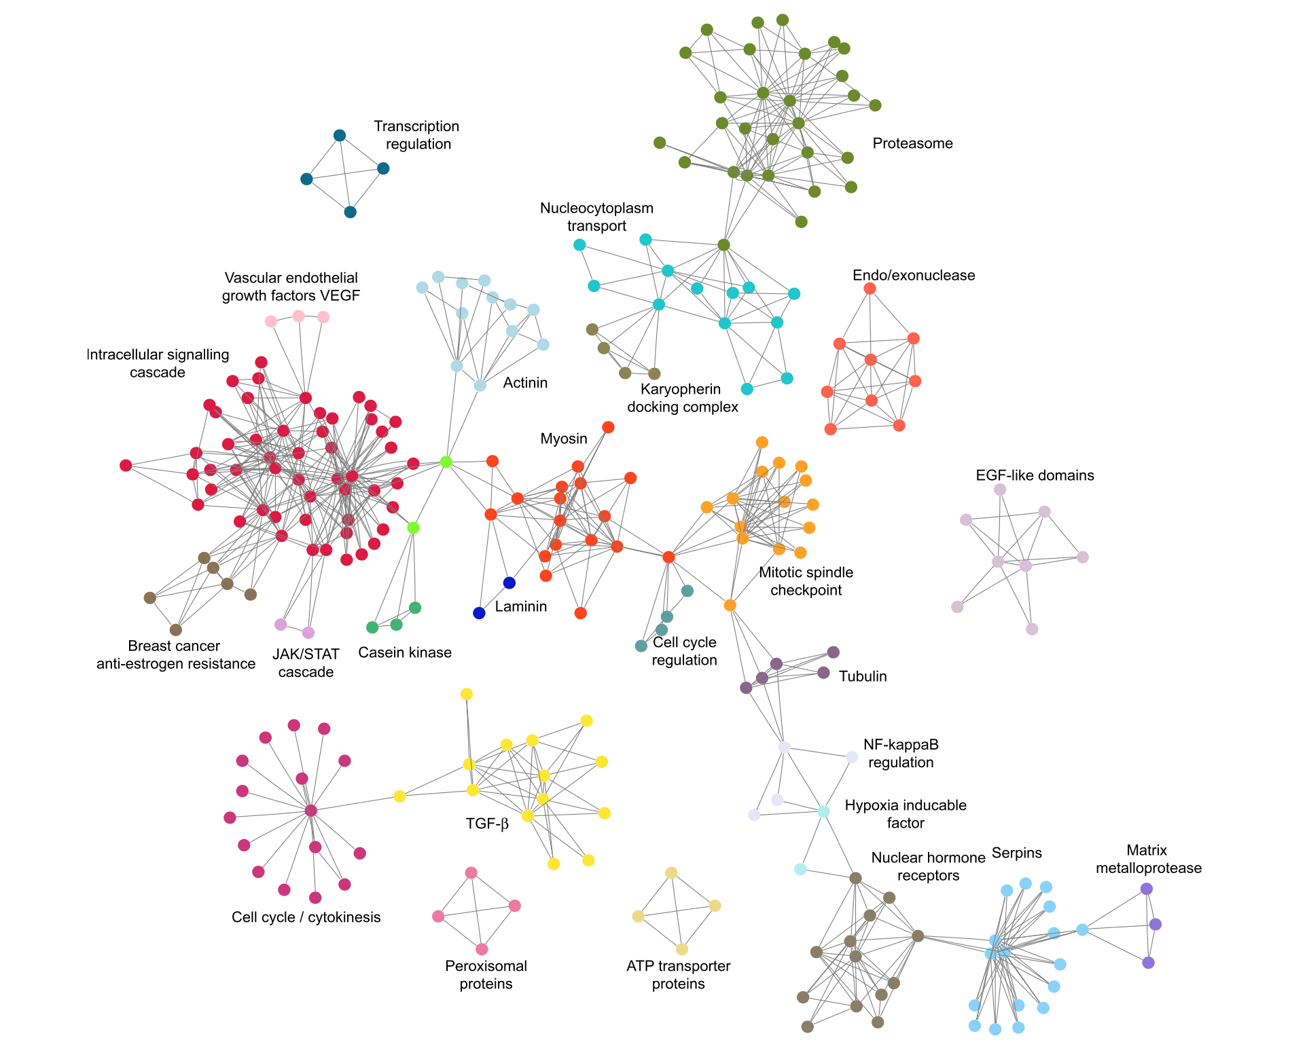
We collect a lot of data...
social networks
street maps
chemical interactions
Image source: S. Fortunato, Community detection in graphs

Slide 7
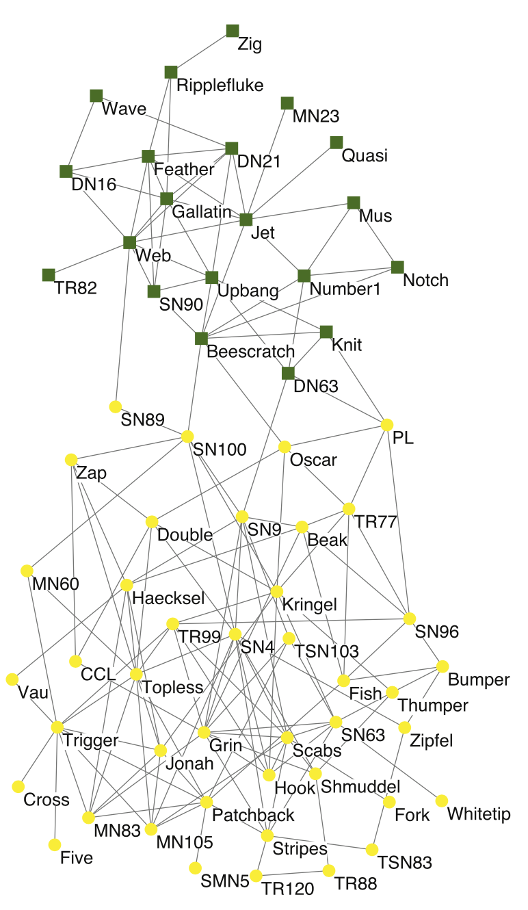
We collect a lot of data...
social networks
street maps
chemical interactions
animal behaviour
Image source: S. Fortunato, Community detection in graphs

Slide 8
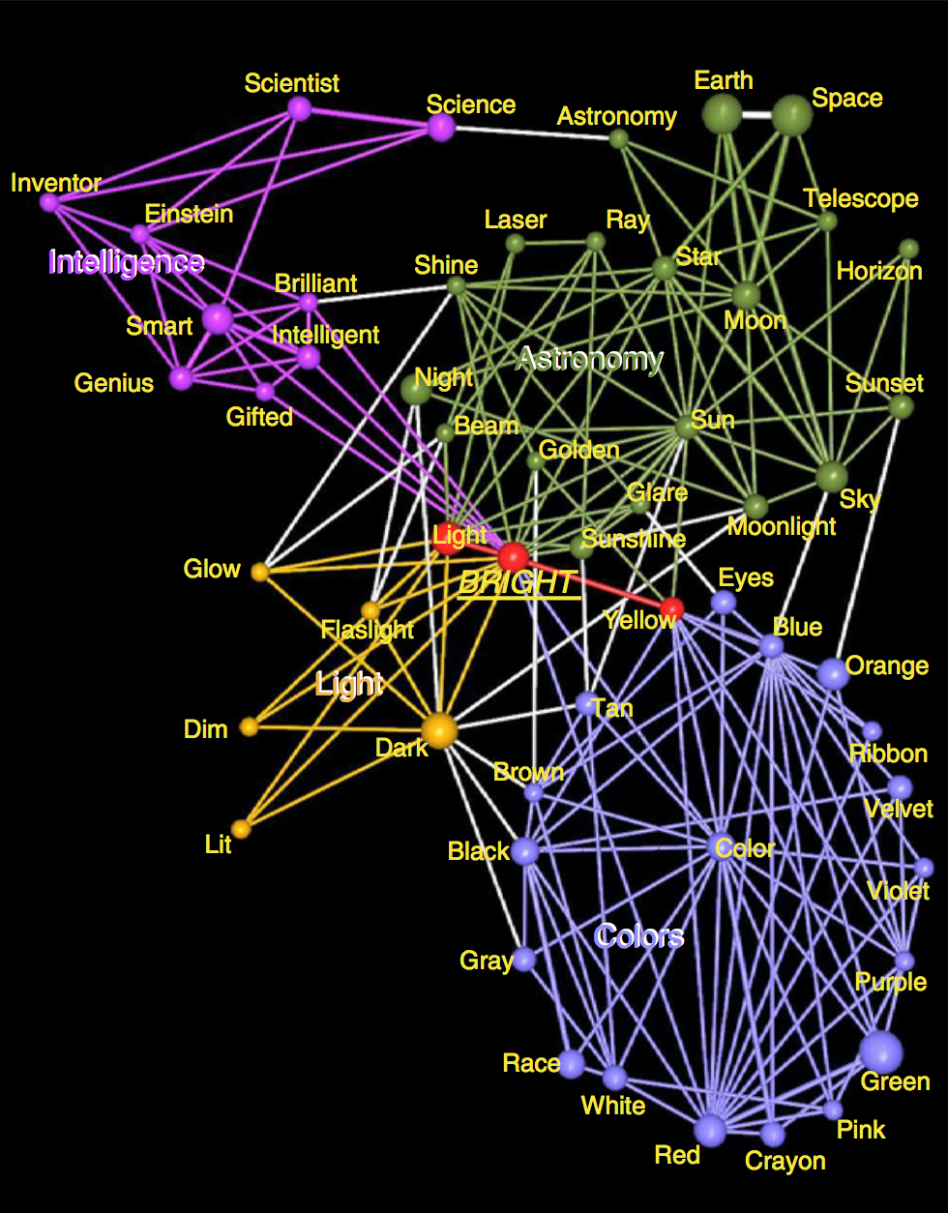
We collect a lot of data...
social networks
street maps
chemical interactions
animal behaviour
word associations
Image source: S. Fortunato, Community detection in graphs

Slide 9
We collect a lot of data...
social networks
street maps
chemical interactions
animal behaviour
word associations
and many more ...

Slide 10
We collect a lot of data...
social networks
street maps
chemical interactions
animal behaviour
word associations
and many more ...
... which we want to model.

Slide 11
We collect a lot of data...
social networks
street maps
chemical interactions
animal behaviour
word associations
and many more ...
→ social groups
... which we want to model.

Slide 12
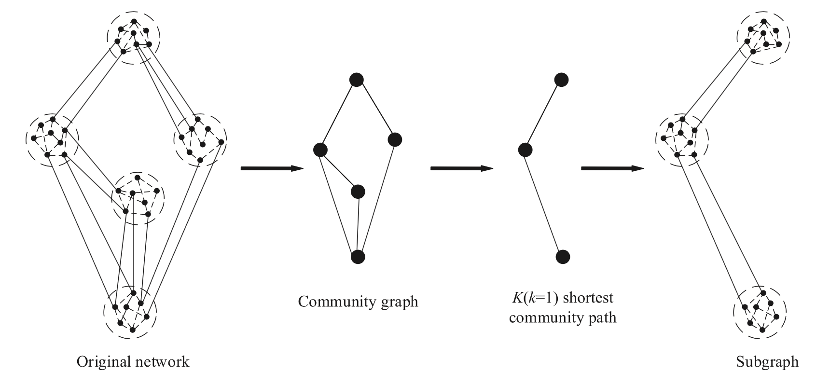
We collect a lot of data...
social networks
street maps
chemical interactions
animal behaviour
word associations
and many more ...
→ social groups
→ cities, villages
Image source: M. Gong et al., 2016
... which we want to model.

Slide 13
We collect a lot of data...
social networks
street maps
chemical interactions
animal behaviour
word associations
and many more ...
→ social groups
→ cities, villages
→ interacting molecules
... which we want to model.

Slide 14
We collect a lot of data...
social networks
street maps
chemical interactions
animal behaviour
word associations
and many more ...
→ social groups
→ cities, villages
→ interacting molecules
→ communities
... which we want to model.

Slide 15
We collect a lot of data...
social networks
street maps
chemical interactions
animal behaviour
word associations
and many more ...
→ social groups
→ cities, villages
→ interacting molecules
→ communities
→ concepts
... which we want to model.

Slide 16
Problem of “community detection”
The data (input)
graph = network = data
vertex = node = object
edge = arc = relation
undirected
sparse

Slide 17
Problem of “community detection”
→

Slide 18
Problem of “community detection”
The result (output)
“communities”
equivalence relation
sets of vertices
possibly overlapping
“strongly connected individuals
with few outgoing connections”

Slide 19
What are the research questions?

Slide 20
Research question 1
What is a good definition for a community such that it’s properties correspond to the intuitive concept of “strongly connected individuals with few outgoing connections”?

Slide 21
Research question 1
What is a good definition for a community such that it’s properties correspond to the intuitive concept of “strongly connected individuals with few outgoing connections”?

Slide 22
Research question 1
What is a good definition for a community such that it’s properties correspond to the intuitive concept of “strongly connected individuals with few outgoing connections”?
Research question 2
How does an algorithm for finding this definition scale with respect to the data size?

Slide 23
Research question 1
What is a good definition for a community such that it’s properties correspond to the intuitive concept of “strongly connected individuals with few outgoing connections”?
Research question 2
How does an algorithm for finding this definition scale with respect to the data size?

Slide 24
Research question 1: definition of community

Slide 25
definition of community
=
measurement of connectedness
→
←
7
6
5
4
3

Slide 26
The perfect community: clique

Slide 27
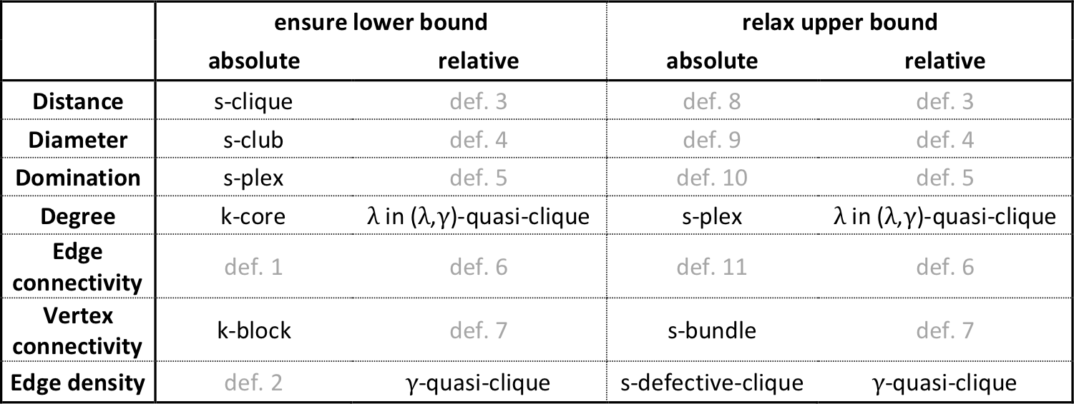
The perfect community: clique

Slide 28
The perfect community: clique
1
The distance is
shortest length of a path between two vertices.

Slide 29
The perfect community: clique
1
The diameter is
largest distance between every pair of vertices.

Slide 30
The perfect community: clique
1
The domination is
smallest number of vertices of which every vertex is a neighbor.

Slide 31
The perfect community: clique

Slide 32
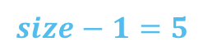
The perfect community: clique
$$size−1=5$$
The degree is
smallest number of neighbors of a vertex.

Slide 33
The perfect community: clique

Slide 34
The perfect community: clique
$$size−1=5$$
The edge connectivity is
smallest number of edge-independent paths
between every pair of vertices.

Slide 35
The perfect community: clique

Slide 36
The perfect community: clique
$$size−1=5$$
The vertex connectivity is
smallest number of vertex-independent paths
between every pair of vertices.

Slide 37
The perfect community: clique

Slide 38

The perfect community: clique
$$size ∗(size−1)=30$$
The edge density is
number of edges.

Slide 39
The perfect community: clique

Slide 40
Clique relaxation framework

Slide 41
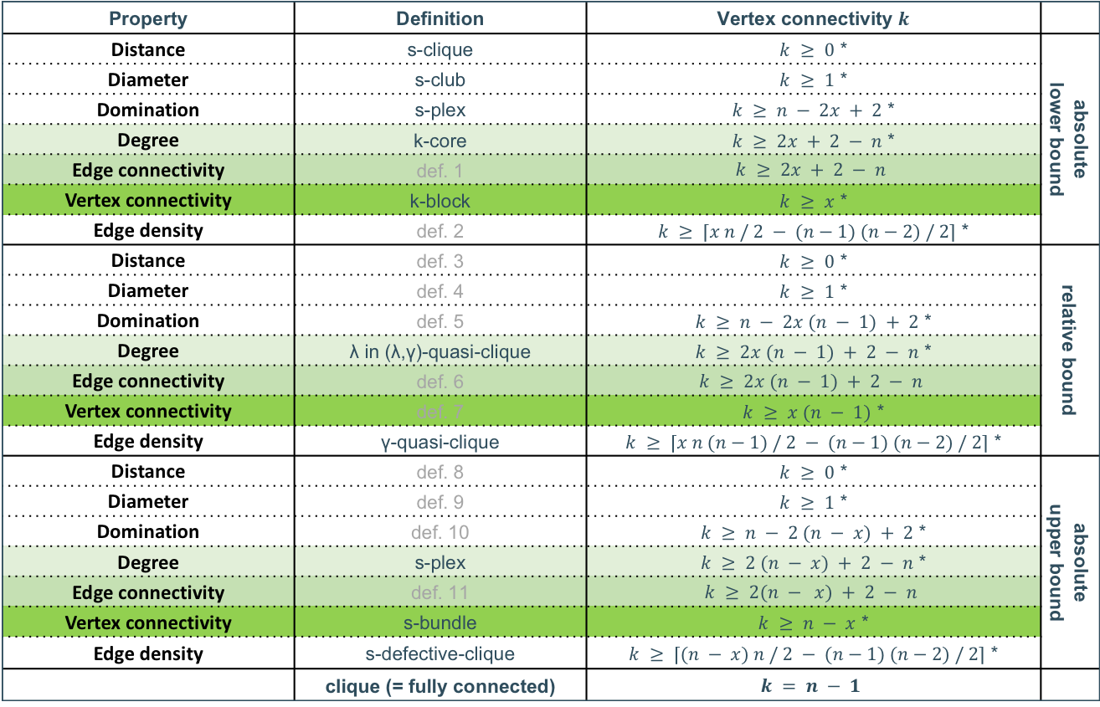
Property | Definition | Vertex connectivity $k$
Distance | s-clique | $k ≥ 0$ * | absolute lower bound
Diameter | s-club | $k ≥ 1$ *
Domination | s-plex | $k ≥ n − 2x + 2$ *
Degree | k-core | $k ≥ 2x + 2 − n$ *
Edge connectivity | def. 1 | $$k ≥ 2x + 2 − n$$
Vertex connectivity | k-block | $k ≥ x$ *
Edge density | def. 2 | $k ≥ ⌈x n / 2 − (n−1) (n−2) / 2⌉$ *
Distance | def. 3 | $k ≥ 0$ * | relative bound
Diameter | def. 4 | $k ≥ 1$ *
Domination | def. 5 | $k ≥ n − 2x (n − 1) + 2$ *
Degree | λ in (λ,γ)-quasi-clique | $k ≥ 2x (n − 1) + 2 − n$ *
Edge connectivity | def. 6 | $$k ≥ 2x (n − 1) + 2 − n$$
Vertex connectivity | def. 7 | $k ≥ x (n − 1)$ *
Edge density | γ-quasi-clique | $k ≥ ⌈x n (n−1) / 2 − (n−1) (n−2) / 2⌉$ *
Distance | def. 8 | $k ≥ 0$ * | absolute upper bound
Diameter | def. 9 | $k ≥ 1$ *
Domination | def. 10 | $k ≥ n − 2 (n − x) + 2$ *
Degree | s-plex | $k ≥ 2 (n − x) + 2 − n$ *
Edge connectivity | def. 11 | $$k ≥ 2(n − x) + 2 − n$$
Vertex connectivity | s-bundle | $k ≥ n − x$ *
Edge density | s-defective-clique | $k ≥ ⌈(n − x) n / 2 − (n−1) (n−2) / 2⌉$ *
 | clique (= fully connected) | $$k = n − 1$$

Slide 42
Whitney’s theorem
≤
≤
Degree connectivity
Edge connectivity
Vertex connectivity
preferred definition

Slide 43
absolute upper vertex connectivity
minimum percentage of edges
relative vertex connectivity
absolute lower vertex connectivity
size of the community

Slide 44
Guarantied properties
Distance | dG(v1, v2) ≤ ⌊(n - 2) / x + 1⌋ | k-block
Diameter | diam(S) ≤ ⌊(n - 2) / x + 1⌋
Domination | |D| ≤ n - x
Degree | δ(S) ≥ x
Edge connectivity | λ(S) ≥ x
Vertex connectivity | κ(S) ≥ x
Edge density | ρ(S) ≥ x / (n - 1)
Distance | dG(v1, v2) ≤ ⌊(n - 2) / (x (n - 1)) + 1⌋ | def. 7
Diameter | diam(S) ≤ ⌊(n - 2) / (x (n - 1)) + 1⌋
Domination | |D| ≤ n - x (n - 1)
Degree | δ(S) ≥ x (n - 1)
Edge connectivity | λ(S) ≥ x (n - 1)
Vertex connectivity | κ(S) ≥ x (n - 1)
Edge density | ρ(S) ≥ x
Distance | dG(v1, v2) ≤ ⌊(n - 2) / (n - x) + 1⌋ | s-bundle
Diameter | diam(S) ≤ ⌊(n - 2) / (n - x) + 1⌋
Domination | |D| ≤ x
Degree | δ(S) ≥ n - x
Edge connectivity | λ(S) ≥ n - x
Vertex connectivity | κ(S) ≥ n - x
Edge density | ρ(S) ≥ (n - x) / (n - 1)

Slide 45
Research question 2: a scalable algorithm

Slide 46
Algorithm to find communities
Algorithm to find a global minimal vertex cut
Algorithm to find a local minimal vertex cut

Slide 47
Local minimal flow-free vertex cut
vertex independent paths
correspond to
minimal vertex cuts

Slide 48
Local minimal flow-free vertex cut
expansion after contraction
of moving wave
at minimal local vertex cut

Slide 49
Local minimal flow-free vertex cut

Slide 50
Local minimal flow-free vertex cut

Slide 51
Local minimal flow-free vertex cut

Slide 52
Local minimal flow-free vertex cut

Slide 53
Local minimal flow-free vertex cut

Slide 54
Local minimal flow-free vertex cut

Slide 55
Local minimal flow-free vertex cut

Slide 56
Global minimal vertex cut

Slide 57
Global minimal vertex cut

Slide 58
Find communities (Moody & White)

Slide 59
Find communities (Moody & White)

Slide 60
Find communities (Moody & White)

Slide 61
Find communities (Moody & White)

Slide 62
Find communities (Moody & White)

Slide 63

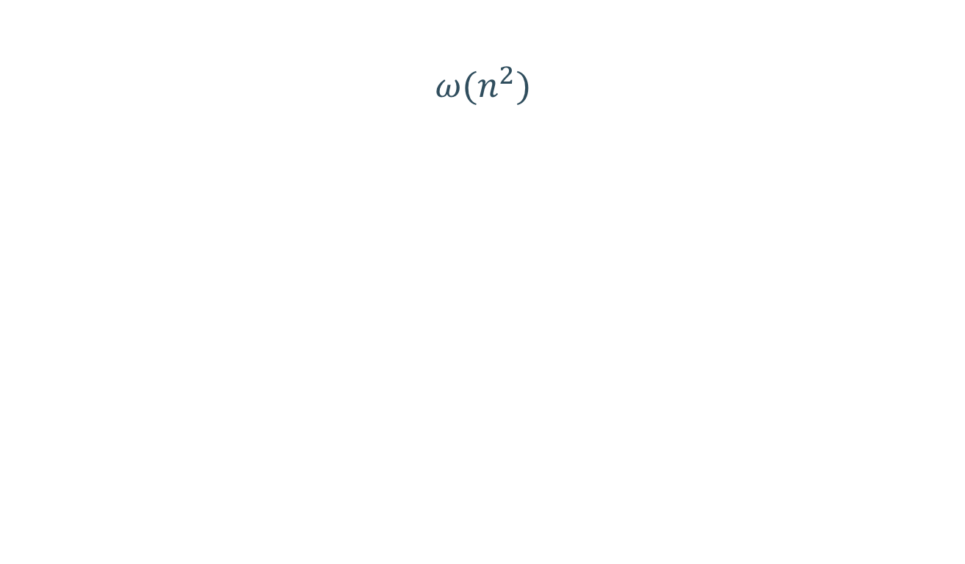

$$ω(n^{2})$$
Algorithm to find communities
Algorithm to find a global minimal vertex cut
$$ω(n^{2})$$
Algorithm to find a local minimal vertex cut
$$ω(n)$$

Slide 64
Thank you! Any questions?
Source code at Github:
https://github.com/MCMXCVII/scale-independent-communities-flow-free-vertex-cut

